Slide 1

Predicting Deposit Morphology of Direct ink writing using conditional Generative Adversarial Network
ECEN 5020 – Deep Learning, Spring 2025
Group 9
Soumya Swaraj Mondal, Md Humaun Kabir, Md Shihab Shakur
Oklahoma State University

Slide 2
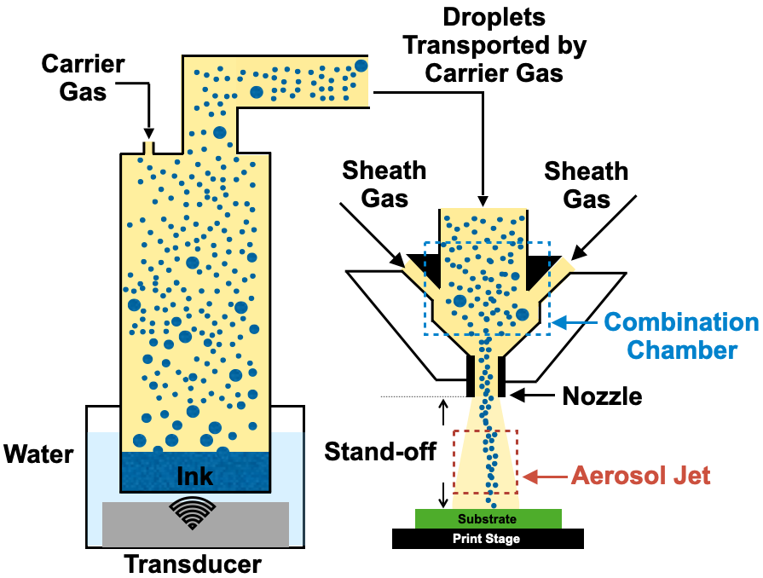
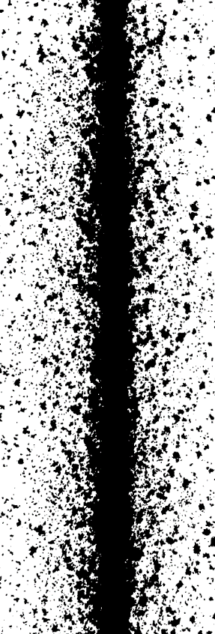
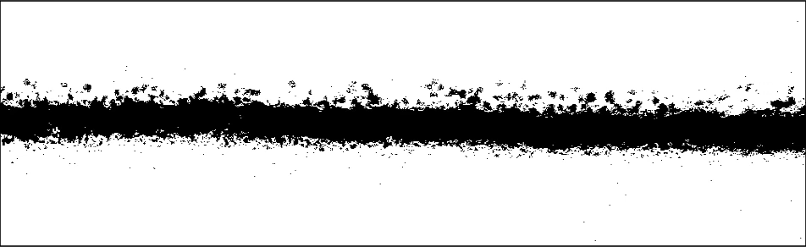
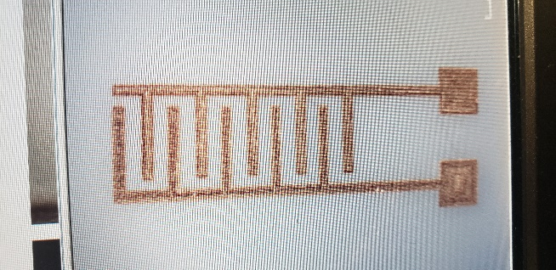
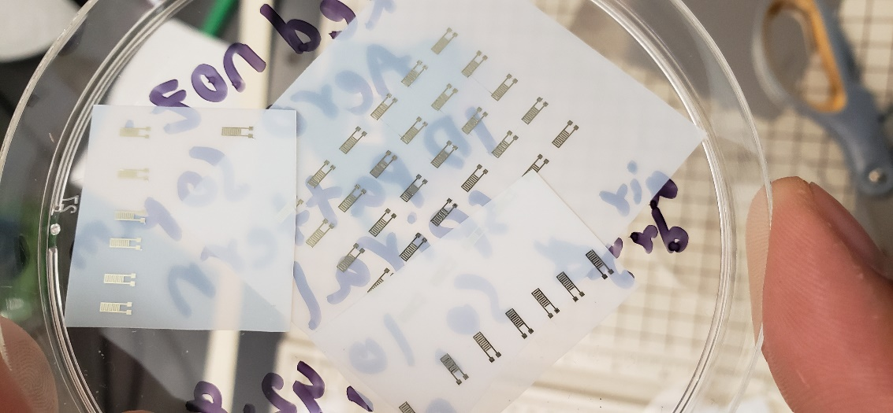
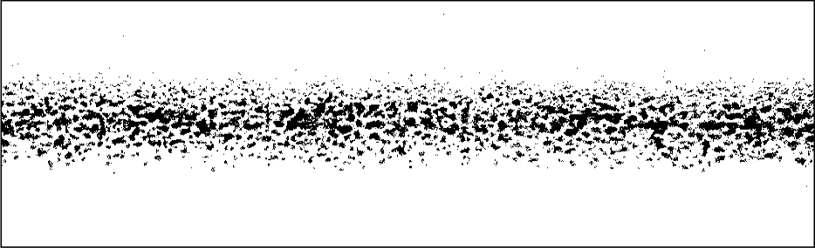
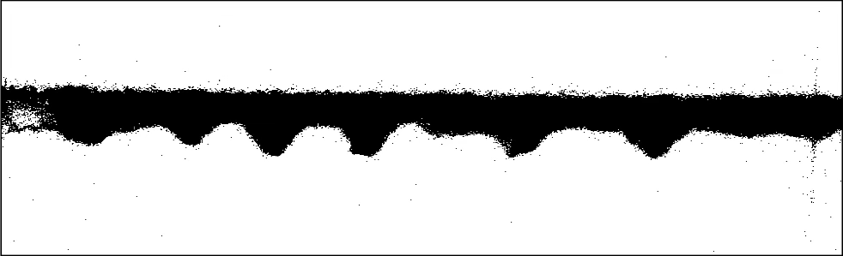
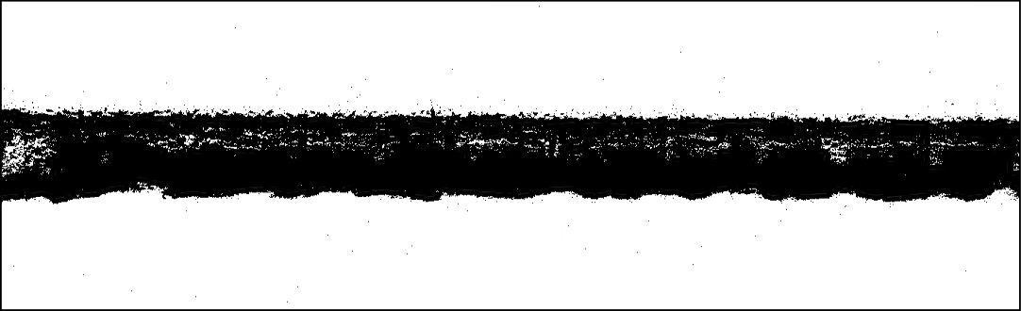
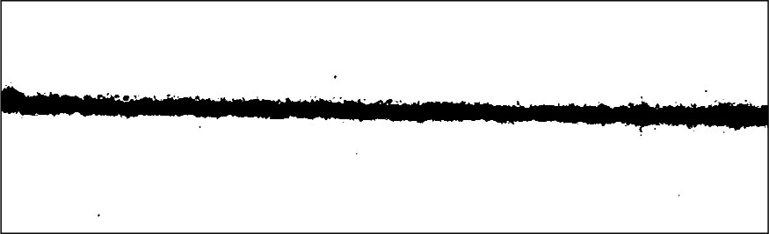
Introduction
AJP is a microscale, direct ink writing process for depositing functional inks on planar and non-planar surfaces, making it well-suited for printed electronics such as Flexible and Wearable Electronics, Microelectronics Packaging, Antenna Fabrication, Biosensors, Embedded Sensors , Multilayer Circuits.
Printed Device
Deposit Morphology
Common Deposit Morphologies
Overspray
Central Trace
Discontinuity
Overspray
1 mm
Pulsed edges
Printing Direction
Edge Roughness
Over-deposition
Nominal
(A)
(B)
(C)
25 µm
(D)
100 µm
Figure 1: (A) Schematic of an ultrasonic AJP process; (B) Silver electrodes printed on a flexible substrate (scale bar: 1 mm); (C) Printed deposit with key morphological attributes (scale bar: 25 µm); (D) Common deposit morphologies in AJP (scale bar: 100 µm).
2

Slide 3
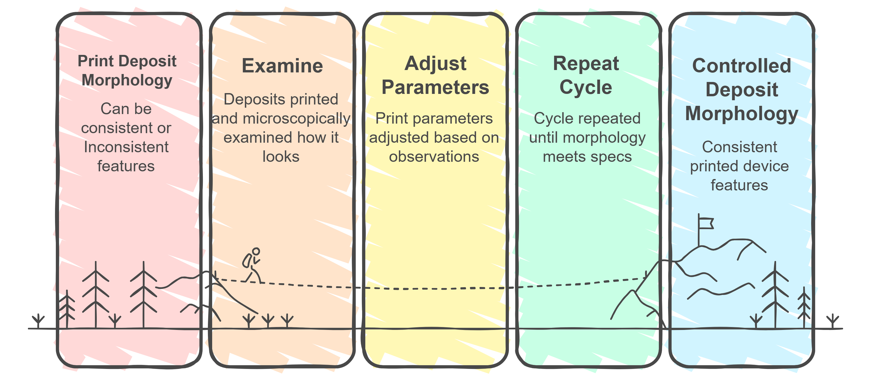
Background Problem
Routine workflow leads to material waste and long production times.
No reliable method to visualize the deposit morphology before the droplet stream impacts the substrate.
3
Notes:
In a routine workflow, deposits are printed, examined microscopically, and print parameters are adjusted based on observations before reprinting. This cycle is repeated until the morphology meets design specifications, leading to material waste and long production times. Despite the influential role of deposit morphology, AJP lacks real-time predictive tools for morphology control. There is currently no reliable method to visualize the deposit morphology before the droplet stream impacts the substrate.

Slide 4
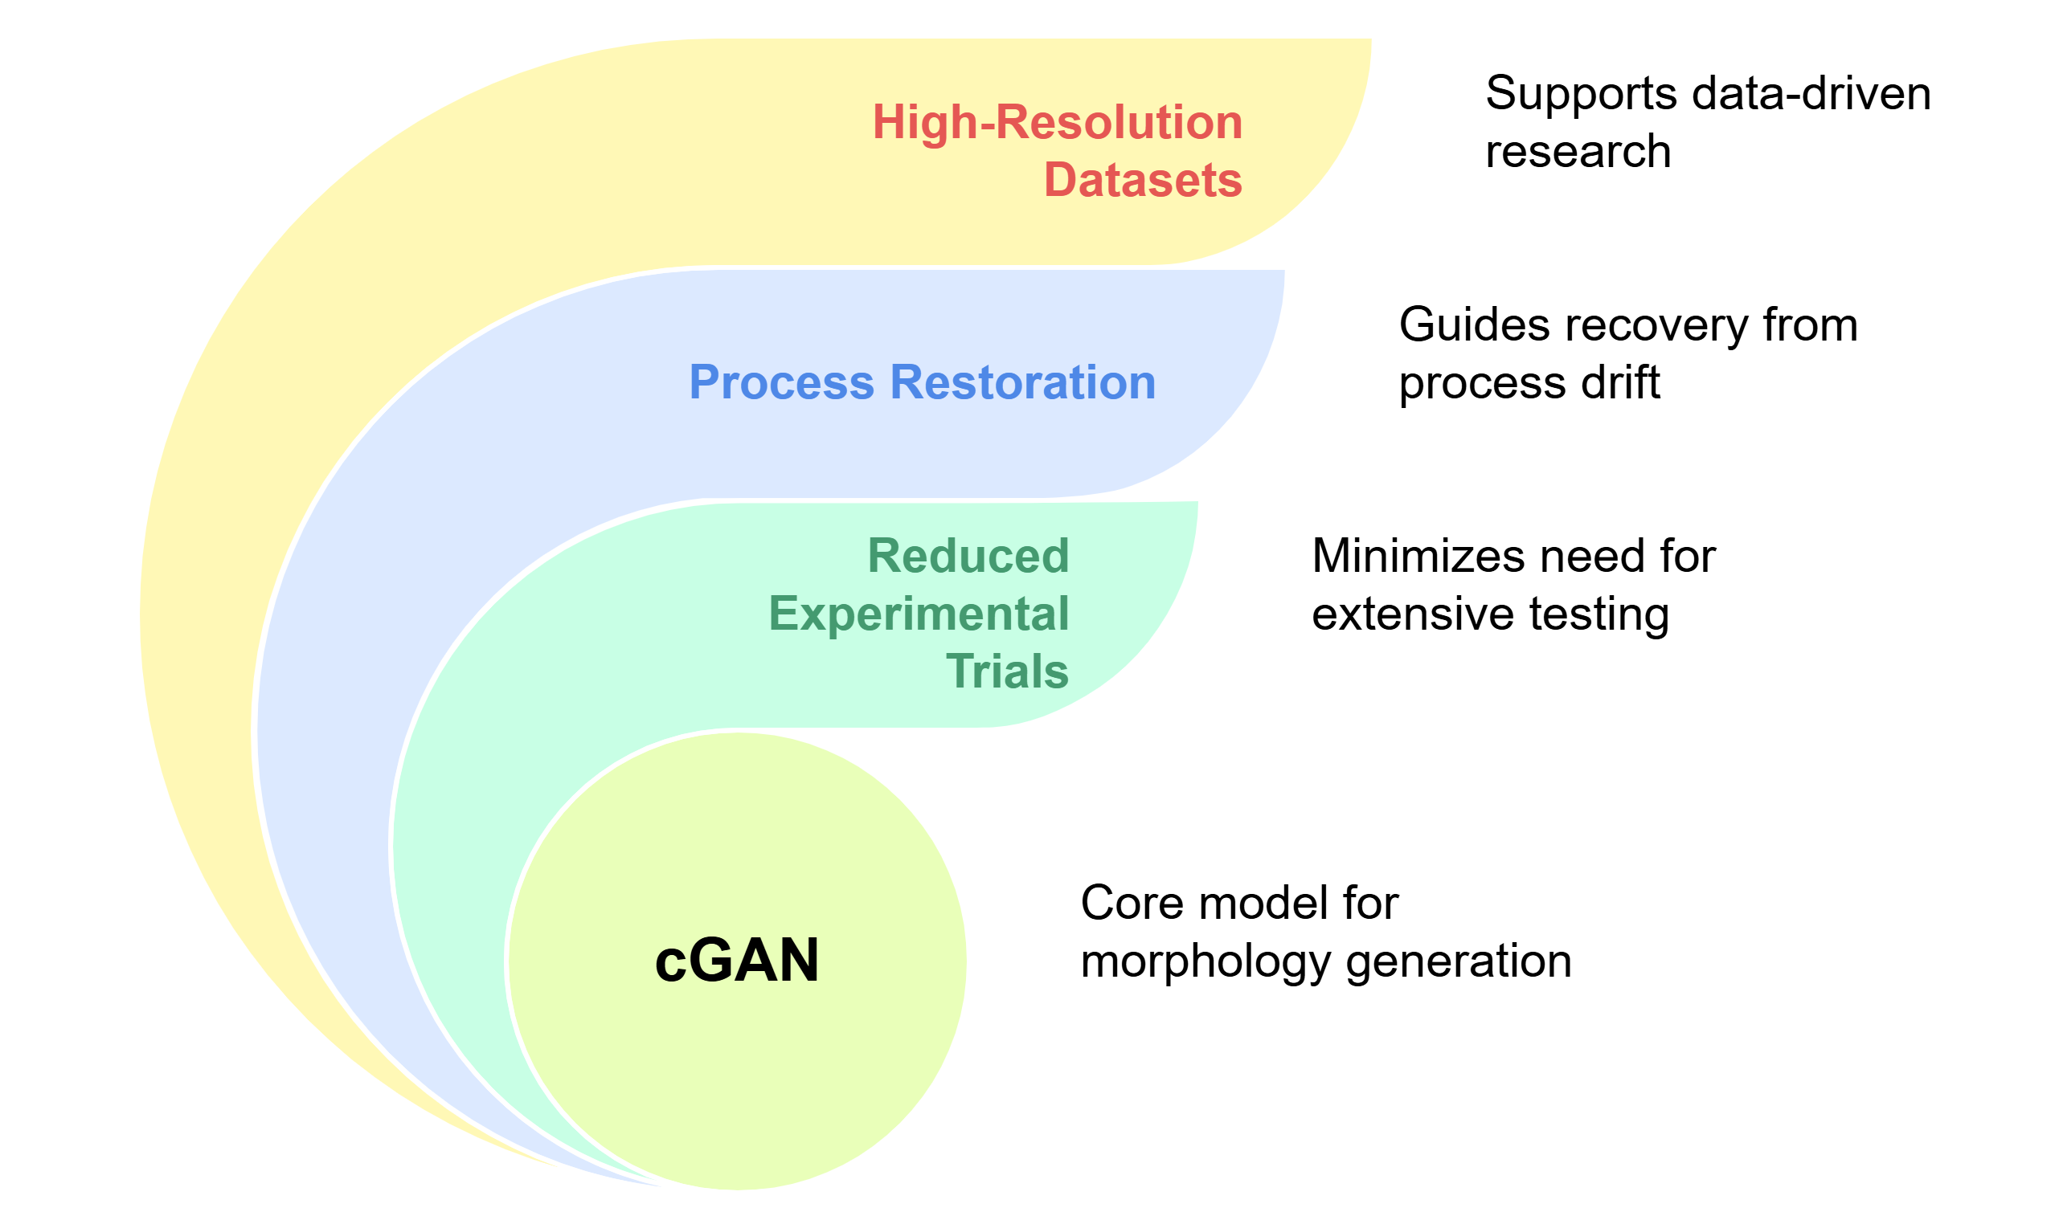
Objectives

Slide 5
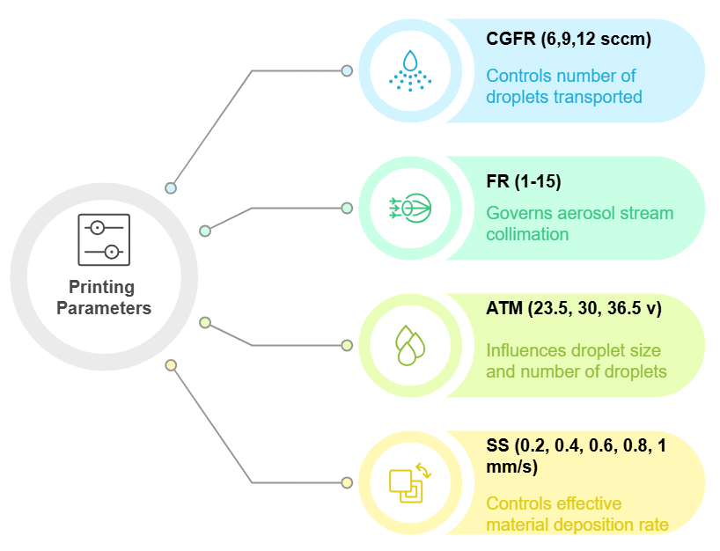
Fabrication of AJP Traces
Ink: UTDAg40X silver nano-ink (40 wt.%, ~1 cP, 28 dyne/cm)
Substrate: Glass microscope slides (cleaned, dried)
Printer: IDS NanoJet™
Nozzle: 30G nozzle (233 ± 3 µm), 2 mm stand-off
Environment: Room temp, compressed air for CG & SG
Experimental Design: 650 combinations × 3 replicates = 1950 traces

Slide 6
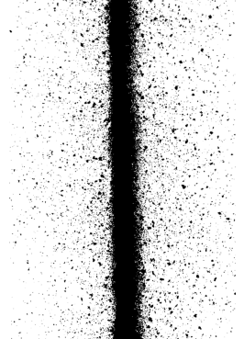
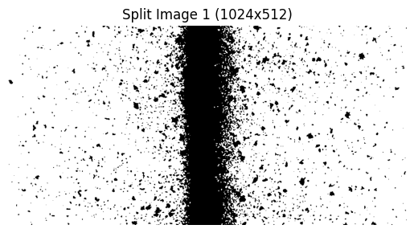
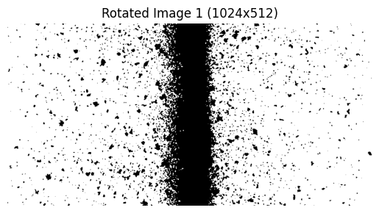
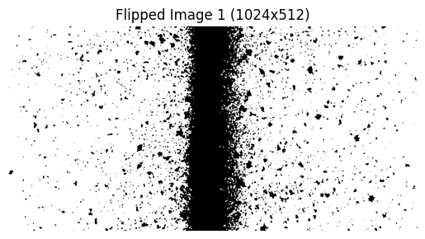
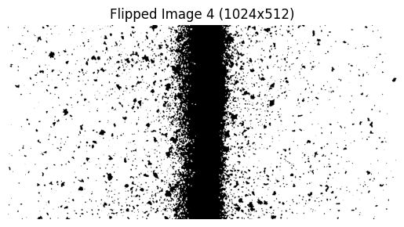
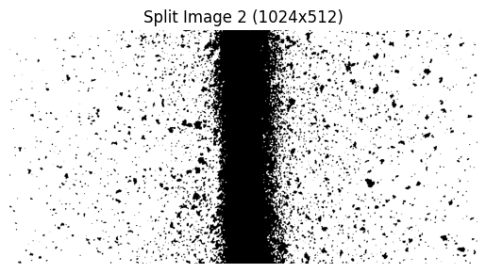
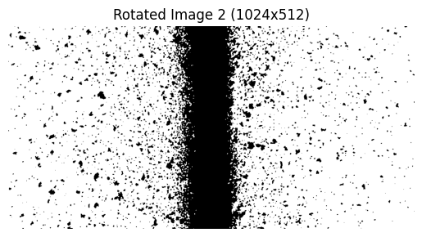
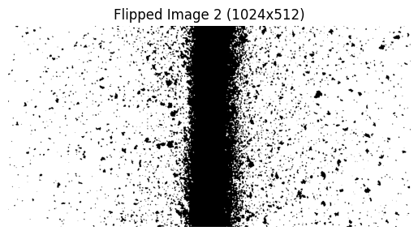
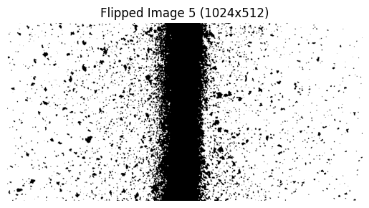
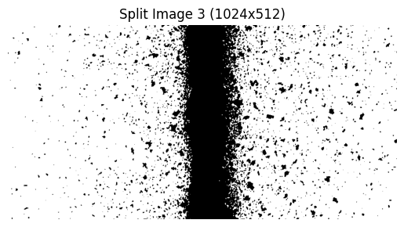
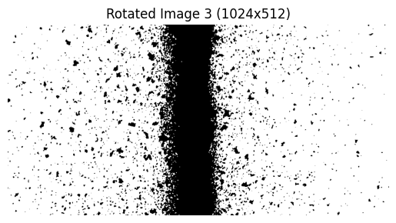
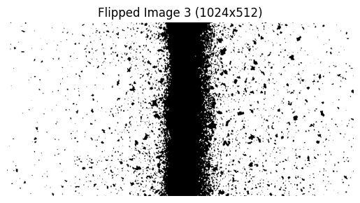
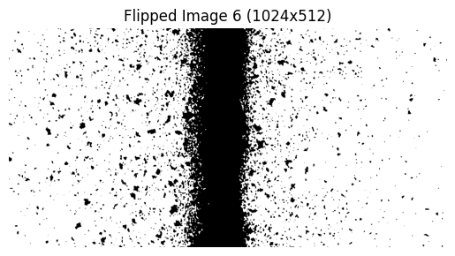
Image Acquisition & Processing
Microscopy: 2048×1534 px at 300× magnification
Processing: Binarized (Otsu) → Cropped → Augmented (rotation, flip)
Final dataset: 23,400 images (512×512 px)
Binarization via Otsu’s Thresholding &
Symmetric Cropping
Vertical Splitting
Rotated by 180º
Horizontal Flipping
1
4
7
10
Original Microscopic Image (RGB)
All 12 images are cropped
2
5
8
11
(2048 x 1536 pixels)
(512 x 512 pixels)
3
6
9
12
(1024 x 1536 pixels)
(1024 x 512 pixels)
(1024 x 512 pixels)
(1024 x 512 pixels)
Figure 2: Image preprocessing and augmentation workflow for AJP-cGAN training.

Slide 7
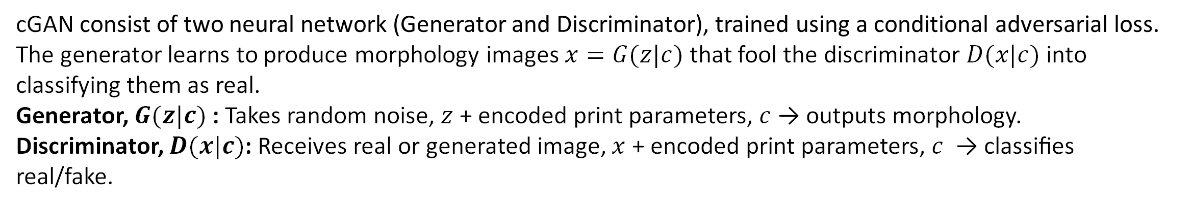
cGAN Architecture
cGAN consist of two neural network (Generator and Discriminator), trained using a conditional adversarial loss. The generator learns to produce morphology images $x=G(z|c)$ that fool the discriminator $D(x|c)$ into classifying them as real.
Generator, $G(z|c)$ : Takes random noise, $z$ + encoded print parameters, $c$ → outputs morphology.
Discriminator, $D(x|c)$: Receives real or generated image, $x$ + encoded print parameters, $c$ → classifies real/fake.
Figure 3: Schematic of the AJP-cGAN architecture for 2D deposit morphology generation.

Slide 8
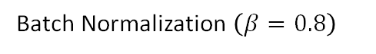
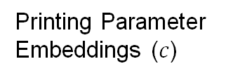
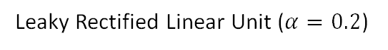
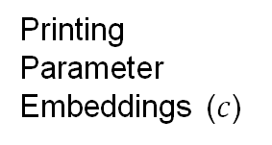
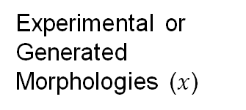
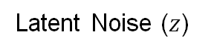
cGAN Architecture
64, 128, 128, 128
64, 128, 128, 128
64, 64, 256, 256
2D Convolutional Layer
64, 128, 64, 64
64, 128, 128, 128
64,128, 256, 256
64,128, 64, 64
64, 64, 256, 256
64, 1, 256, 256
64, 2097152
64, 128, 128, 128
64, 64, 256, 256
64, 1, 256, 256
Leaky Rectified Linear Unit ($α=0.2$)
Printing Parameter
Embeddings ($c$)
Batch Normalization $\left(β=0.8\right)$
Flatten
Generated Morphologies
(64x1x256x256)
Sigmoid
Latent Noise ($z$)
Linear Transformation
Reshape
Upsample (Scale factor = 2)
Tanh
64d
128d
128d
128d
128d
128d
128d
128d
64d
64d
64d
1d
1d
64, 16, 128, 128
64, 32, 64, 64
64, 32, 64, 64
64, 64, 32, 32
64, 128, 32, 32
64, 256, 16, 16
64, 256, 16, 16
64, 1024, 4, 4
64, 1024, 4, 4
64, 16, 128, 128
64, 32, 64, 64
64, 256, 8, 8
64, 256, 8, 8
64, 16384
Experimental or Generated Morphologies ($x$)
64, 128, 32, 32
64, 256, 16, 16
64, 256, 8, 8
64, 1024, 4, 4
64, 1
Real/Fake
Classification
(Scalar output)
Printing Parameter
Embeddings ($c$)
128d
128d
64d
64d
64d
32d
32d
32d
16d
16d
16d
8d
8d
8d
4d
4d
4d
1d
1d
Figure 3: Architectures of the generator (top) and discriminator (bottom) in AJP-cGAN.

Slide 9
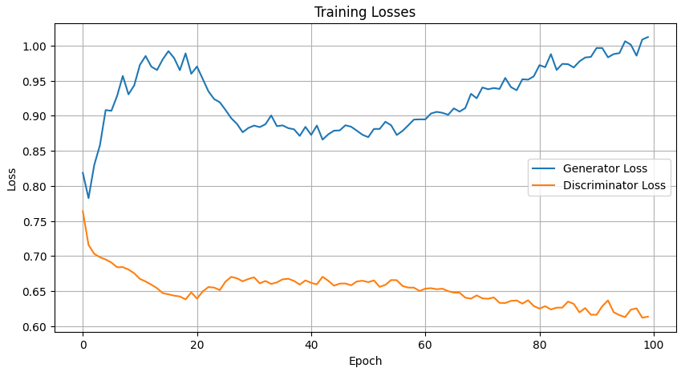
Training Strategy
The AJP-cGAN model is trained using standard conditional GAN loss:
$$\min_{G}{\max_{D}{𝔼_{c,x}\left[\log{D\left(x | c\right)}\right]}+𝔼_{c,z}\left[\log\left(1−D\left(G\left(z | c\right) | c\right)\right)\right]}$$
Discriminator: real image
Generator: Adversarial objective (fooling)
Discriminator: fake image
Figure 4: Training loss vs Epoch

Slide 10
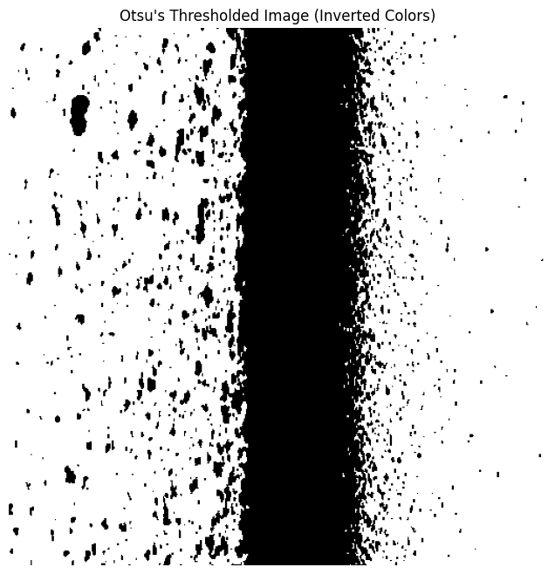
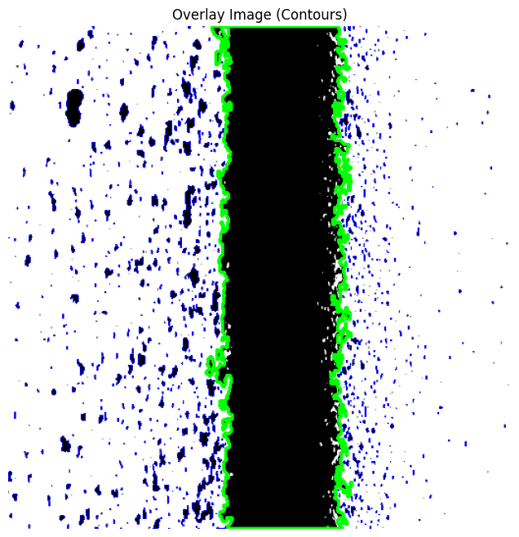
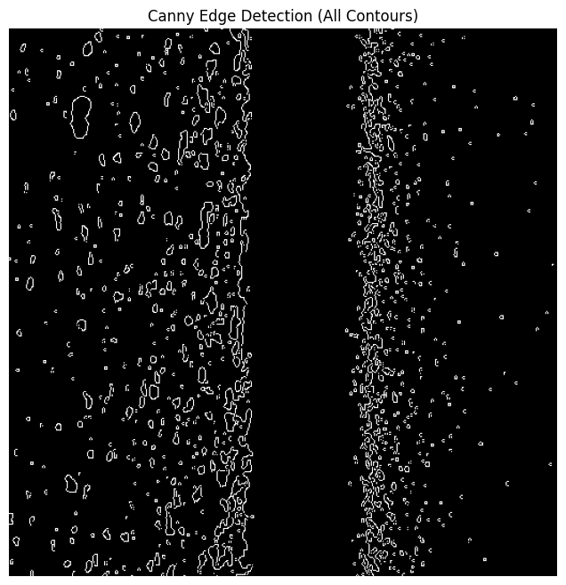
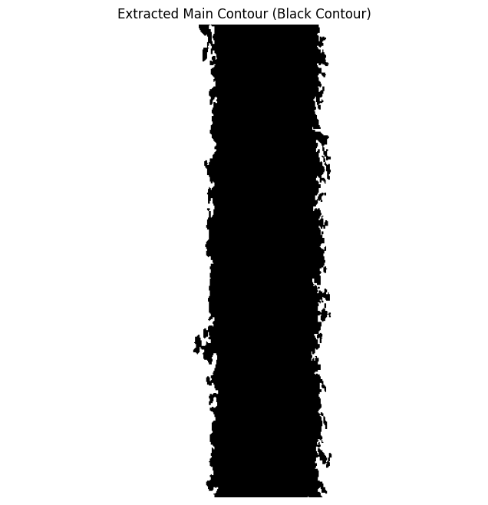
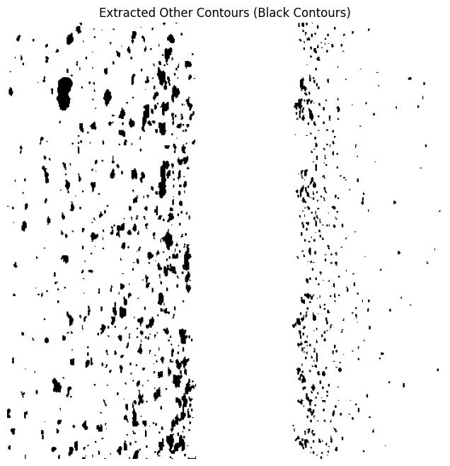
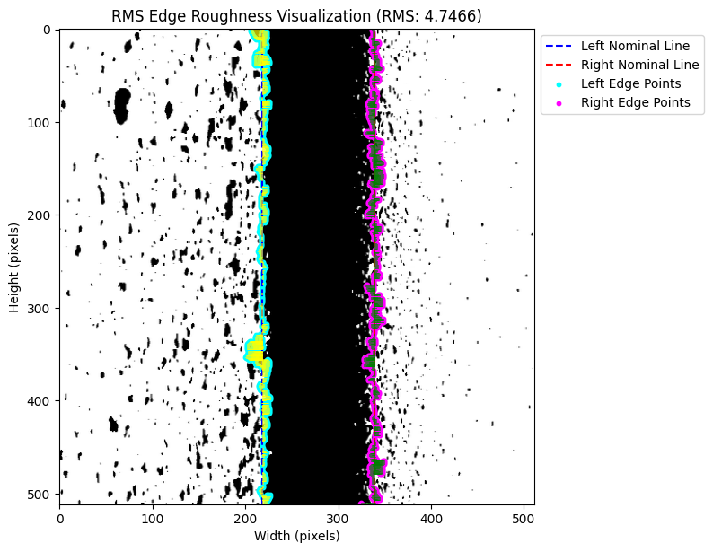
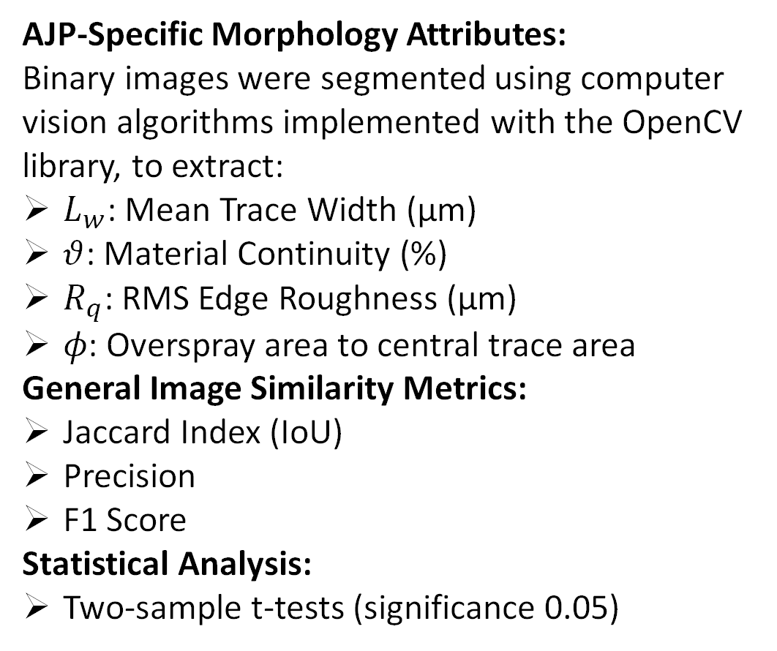
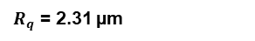
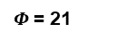
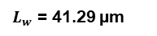
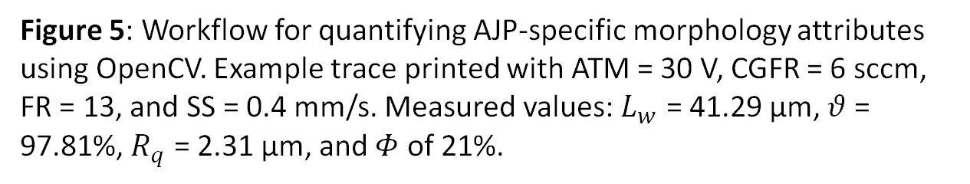
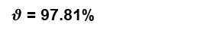
Evaluation Metrics
AJP-Specific Morphology Attributes:
Binary images were segmented using computer vision algorithms implemented with the OpenCV library, to extract:
$L_{w}$: Mean Trace Width (µm)
$θ$: Material Continuity (%)
$R_{q}$: RMS Edge Roughness (µm)
𝜙: Overspray area to central trace area
General Image Similarity Metrics:
Jaccard Index (IoU)
Precision
F1 Score
Statistical Analysis:
Two-sample t-tests (significance 0.05)
Trace Boundary
Overspray Boundary
Left Nominal Line
Right Nominal Line
Left Edge Points
Right Edge Points
Binarized Image
Extracted Contours
Canny Edge Detection
$L_{w}$ = 41.29 µm
$θ$ = 97.81%
$Φ$= 21
$R_{q}$ = 2.31 µm
Central Trace
Overspray
Edge Roughness
5
Figure 5: Workflow for quantifying AJP-specific morphology attributes using OpenCV. Example trace printed with ATM = 30 V, CGFR = 6 sccm, FR = 13, and SS = 0.4 mm/s. Measured values: $L_{w}$ = 41.29 µm, $θ$ = 97.81%, $R_{q}$ = 2.31 µm, and $Φ$ of 21%.
Notes:
The laser beam melts a microscopic layer on the surface, which re-solidifies under shielding gas protective conditions, resulting in a smoother surface
The process depends mainly on three factors: the surface material, its initial topography and the energy density of the laser beam
Laser energy density is high which makes it possible to melt a microscopic area without affecting the surrounding areas
Usual technique is to maximize the beam diameter increasing the focal offset distance and fitting the power and feed rate in order to obtain the desired energy density. This way, a larger area can be processed increasing the productivity of the process

Slide 11
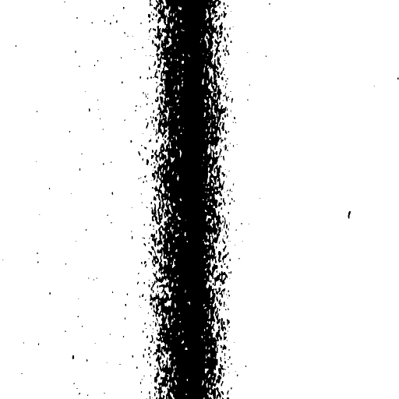
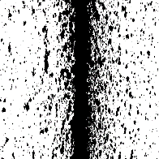
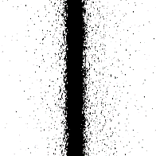
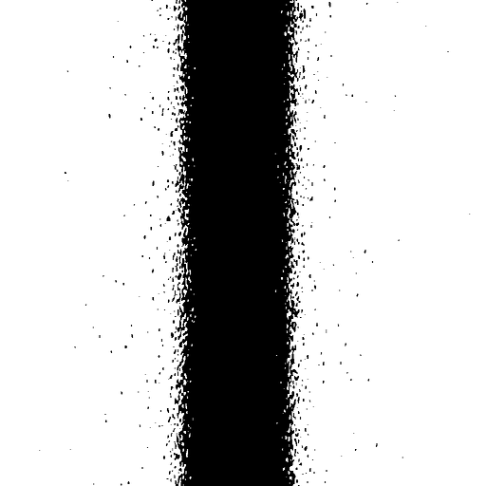
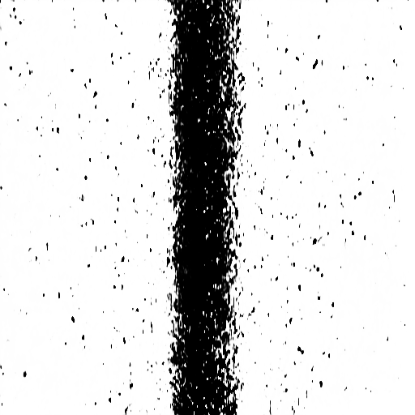



























Overall Model Performance
(A)
Experimental Morphologies
AJP-cGAN Generated Morphologies
23.5, 3, 9, 1
36.5, 13, 9, 0.8
23.5, 4, 12, 0.6
30, 5, 6, 0.4
23.5, 3, 9, 1
36.5, 13, 9, 0.8
23.5, 4, 12, 0.6
30, 5, 6, 0.4
36.5, 6, 9, 0.6
30, 2, 6, 0.4
23.5, 3, 6, 0.2
30, 7, 9, 0.8
36.5, 6, 9, 0.6
30, 2, 6, 0.4
23.5, 3, 6, 0.2
30, 7, 9, 0.8
36.5, 8, 6, 0.2
30, 2, 12, 1
23.5, 12, 6, 1
36.5, 10, 6, 0.4
36.5, 8, 6, 0.2
30, 2, 12, 1
23.5, 12, 6, 1
36.5, 10, 6, 0.4
30, 13, 9, 0.6
23.5, 11, 12, 0.8
36.5, 1, 12, 1
23.5, 15, 9, 0.2
30, 13, 9, 0.6
23.5, 11, 12, 0.8
36.5, 1, 12, 1
23.5, 15, 9, 0.2
Figure 6: Comparison of experimental and AJP-cGAN-generated morphologies across 16 print conditions. (A) Experimental data and predictions, labeled by ATM, FR, CGFR, SS. (B- D) Kernel density estimates comparing experimental (blue) and generated (red) distributions for $L_{w}$, $Φ$, $R_{q}$.

Slide 12


















Effect of FR on Predicted Morphology
X
Experimental
Y
Experimental
Generated
50 µm
Jaccard Index (IoU)
Generated
Precision
50 µm
F1 Score
FR = 2
FR = 6
FR = 15
P = 0.23
P = 0.93
P = 0.25
P = 0.88
P = 0.89
P = 0.37
Overspray to Trace Area Ratio ($Φ$)
Trace Width ($L_{w}$) [µm]
RMS Edge Roughness ($R_{q}$) [µm]
P = 0.82
P = 0.81
P = 0.14
FR = 2
FR = 6
FR = 15
FR = 2
FR = 6
FR = 15
FR = 2
FR = 6
FR = 15

Slide 13


















Impact of CGFR on Predicted Morphology
Experimental
X
Y
Generated
Experimental
Jaccard Index (IoU)
50 µm
Precision
Generated
F1 Score
50 µm
CGFR = 6
CGFR = 9
CGFR = 12
P = 0.23
P = 0.53
P = 0.27
P = 0.67
P = 0.74
P = 0.56
Trace Width ($L_{w}$) [µm]
RMS Edge Roughness ($R_{q}$) [µm]
Overspray to Trace Area Ratio ($Φ$)
P = 0.11
P = 0.59
P = 0.27
CGFR = 6
CGFR = 9
CGFR = 12
CGFR = 6
CGFR = 9
CGFR = 12
CGFR = 6
CGFR = 9
CGFR = 12

Slide 14


















Impact of ATM on Predicted Morphology
X
Experimental
Y
Experimental
Generated
50 µm
Jaccard Index (IoU)
Precision
Generated
50 µm
F1 Score
ATM = 23.5
ATM = 30
ATM = 36.5
P = 0.25
P = 0.1
P = 0.82
P = 0.25
P = 0.64
P = 0.66
P = 0.83
RMS Edge Roughness ($R_{q}$) [µm]
Trace Width ($L_{w}$) [µm]
Overspray Droplet Size (${CA}_{OS}$ ) [${\text{µ}\text{m}}^{2}$]
P = 0. 73
P = 0.87

Slide 15









Impact of Stage Speed on Predicted Morphology
X
Y
Experimental
Experimental
Generated
50 µm
Jaccard Index (IoU)
Precision
Generated
F1 Score
50 µm
SS = 0.2
SS = 0.6
SS = 1
P = 0.28
P = 0.88
Trace Width ($L_{w}$) [µm]
P = 0.72
SS = 0.2
SS = 0.6
SS = 1
SS = 0.2
SS = 0.6
SS = 1

Slide 16

cGAN Predicted Scenarios
Scenario A: Accurate Prediction of Deposit Morphology
Scenario B: Over-prediction and Overspray Artifacts
Scenario C: Prediction under Experimentally Unviable Conditions

Slide 17


Limitations of cGAN model
❌Poor convergence or instability
❌Inability to capture fine-grained structures
❌Slow or inefficient learning
Residual Conditional GAN

Slide 18
cGAN vs Residual cGAN
Component | cGAN Generator | Residual Block cGAN Generator
Input | z + embedded labels | z + embedded labels
First Linear Layer | Linear → reshape to (B, 128, H, W) | Linear → reshape to (B, 128, H, W)
Upsampling Strategy | Upsample → Conv → BN → LeakyReLU (×2–3) | Upsample → Conv → BN → PReLU (×2)
Residual Block | ❌ Not present | ✅ Conv → BN → PReLU → Conv → BN + skip
Activation Functions | LeakyReLU | PReLU
Normalization | BatchNorm2d | BatchNorm2d
Output Layer | Conv2d(→ 1) → Tanh() | Conv2d(→ 1) → Tanh()
Final Output Shape | (B, 1, 256, 256) | (B, 1, 256, 256)
Notes:
A residual block learns a residual function — that is, instead of learning the full transformation from input to output, it learns the difference (residual) between the input and the desired output. It does this by adding the input directly to the output of a few convolutional layers via a skip connection.
PReLU improves upon Leaky ReLU by making the slope for negative inputs a learnable parameter, while Leaky ReLU uses a fixed, predefined slope.

Slide 19














Residual cGAN Results
Effect of SS
Effect of FR
Effect of CGFR
Effect of ATM
SS = 0.2
FR = 2
CGFR = 6
ATM= 23.5
SS = 0.4
FR = 4
CGFR = 9
ATM= 30
SS = 0.8
FR = 12
CGFR = 12
ATM= 36.5
SS = 1
FR = 15
ATM= 23, CGFR=6, FR= 2
ATM= 30, CR=9, SS= 0.2
ATM= 30, FR=2, SS= 0.8
CGFR= 6, FR=8, SS= 0.2

Slide 20
Conclusion and Future Works
AJP-cGAN successfully predicts high-resolution deposit morphology conditioned on print parameters.
The model captures printing parameter-to-structure mappings with strong similarity to experimental data.
Enables pre-print visualization, reducing reliance on trial-and-error experimentation.
Future works:
Integrate Physics-informed constraints
Conditional diffusion models, Style-based noise modulation
Extend model to predict functional properties.
Integrate additional process signals, such as time, RGB, to capture time-dependent dynamics.

Slide 21
Thank you!
Questions?

